Slide 1

Jeopardy! Tutorial
This template is ready to use but since Jeopardy! is a quiz show, you can change the questions and answers of the template, in order to adapt the game to your topics.
Please do not delete whole slides, otherwise we can not guarantee a smooth game experience and problems may occur.
However, you can change texts, the music and colours. In the next slides we will give you a detailed explanation to learn how to play the game and adapt it to your ideas.
Have a lot of fun with our JEOPARDY! game!

Slide 2
Rules of Jeopardy!
To start the game, click on the first Jeopardy! Slide and start the presentation by clicking on the menu Slide Show > From Current Slide.
Now the intro with music starts playing and you only must click one more time to run the begin animation. When the second money board appears, the first player can choose the category and money- value by clicking on the field. (With the increasing amount of money, the difficulty of the questions also increases!)
As soon the question appears, the players have 30 seconds to think about it. (until music ends) When one person raises his arm (or shouts) he/ she can answer. Answers must be phrased as questions, unless it’s said differently.
Right answer? Then the player gets the amount of money, the question is worth. Take a sheet and write down the value to the persons' name. If he guessed it wrong, the other players could try their luck. If time runs out, or no one got it, no one will get any points. The person with the highest amount of money, wins.
Advanced version: guessing it wrong will subtract the amount of money from the players account; negative values are also accurate.

Slide 3
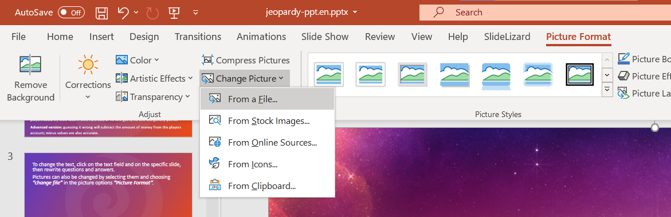

To change the text, click on the text field on the specific slide, then rewrite questions and answers.
Pictures can also be changed by selecting them and choosing “From a File” in the picture options “Picture Format”.
Some pictures are hidden behind other elements. In order to change them, move objects around and bring them to the front or back by right-clicking them and choosing the option.

Slide 4

More information can be found on our blog:
https://slidelizard.com/blog/jeopardy-powerpoint-template

Slide 6

PLEASE CLICK TO START THE GAME!

Slide 7







$ 200
$ 200
$ 200
$ 200
$ 200
$ 200
$ 400
$ 400
$ 400
$ 400
$ 400
$ 400
$ 600
$ 600
$ 600
$ 600
$ 600
$ 600
$ 800
$ 800
$ 800
$ 800
$ 800
$ 800
$ 1000
$ 1000
$ 1000
$ 1000
$ 1000
$ 1000

Slide 8


Slide 9
Formulas!

Slide 11
Angles?

Slide 13
The Unit Circle
What is 1?

Slide 15

Ratios
$θ$ is the best!

Slide 17
Equations
2 Solutions?

Slide 19
Misc.
What are the rules?

Slide 20

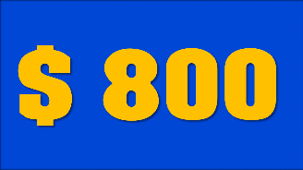





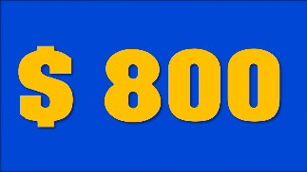
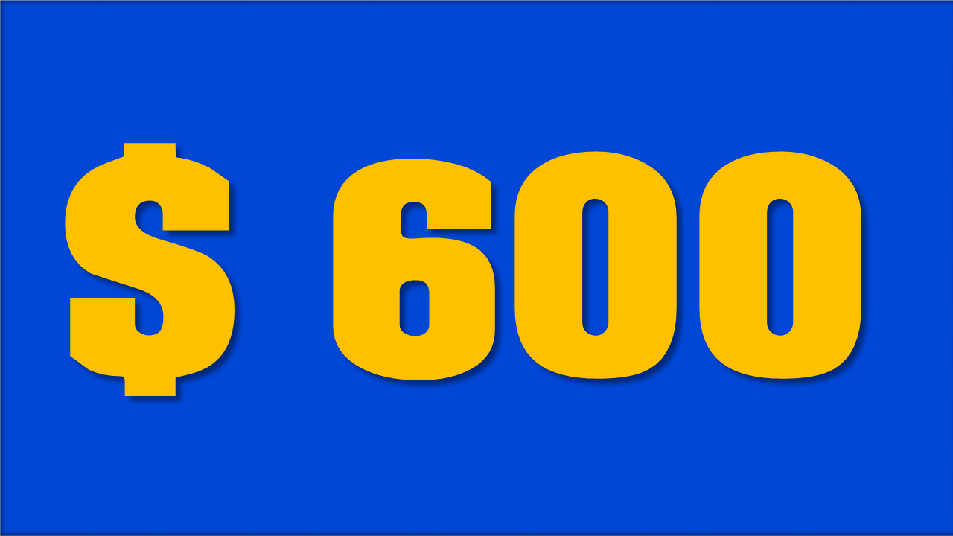




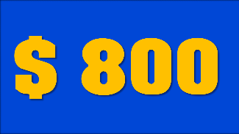







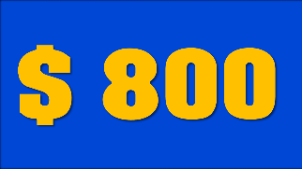




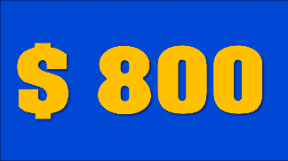






Angle & Angle Measures
Trigonome-tric Ratios
Trigonometric Equations
Formulas
The Unit Circle
Misc.
YOU FINISHED THIS GAME
TIME TO COUNT THE MONEY!

Slide 21
State the formula for arc lengths using radians
Click here for the answer

Slide 22

Solution:
$$a=rθ$$
$ 200

Slide 23
State the equation of a circle at the origin.
Click here for the answer

Slide 24

Solution:
$$x^{2}+y^{2}=1$$
$ 400

Slide 25
Rearrange the unit circle equation to solve for 𝑥.
Click here for the answer

Slide 26
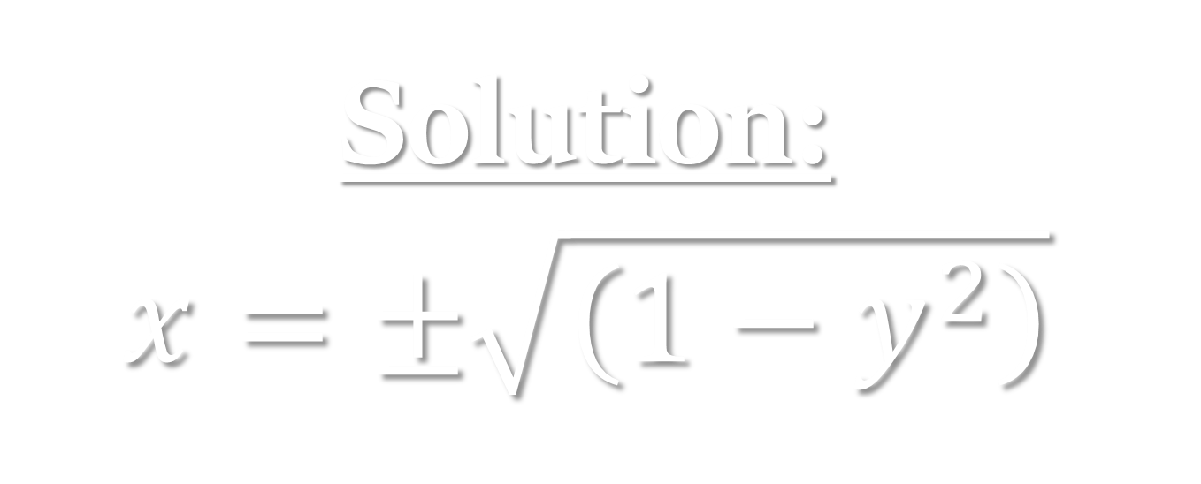
Solution:
$$x=±\sqrt{\left(1−y^{2}\right)}$$
$ 600

Slide 27
What is the relationship between diameter and radius?
Click here for the answer

Slide 28
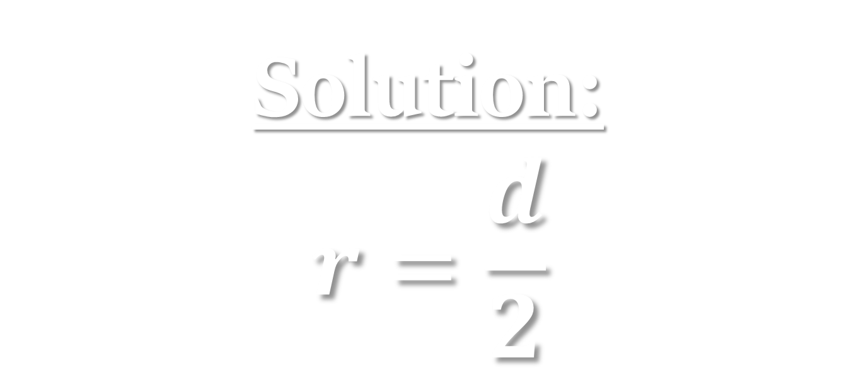
Solution:
$$r=\frac{d}{2}$$
$ 800

Slide 29
State the identities for the six trig ratios using 𝑥,𝑦,𝑟.
Click here for the answer

Slide 30
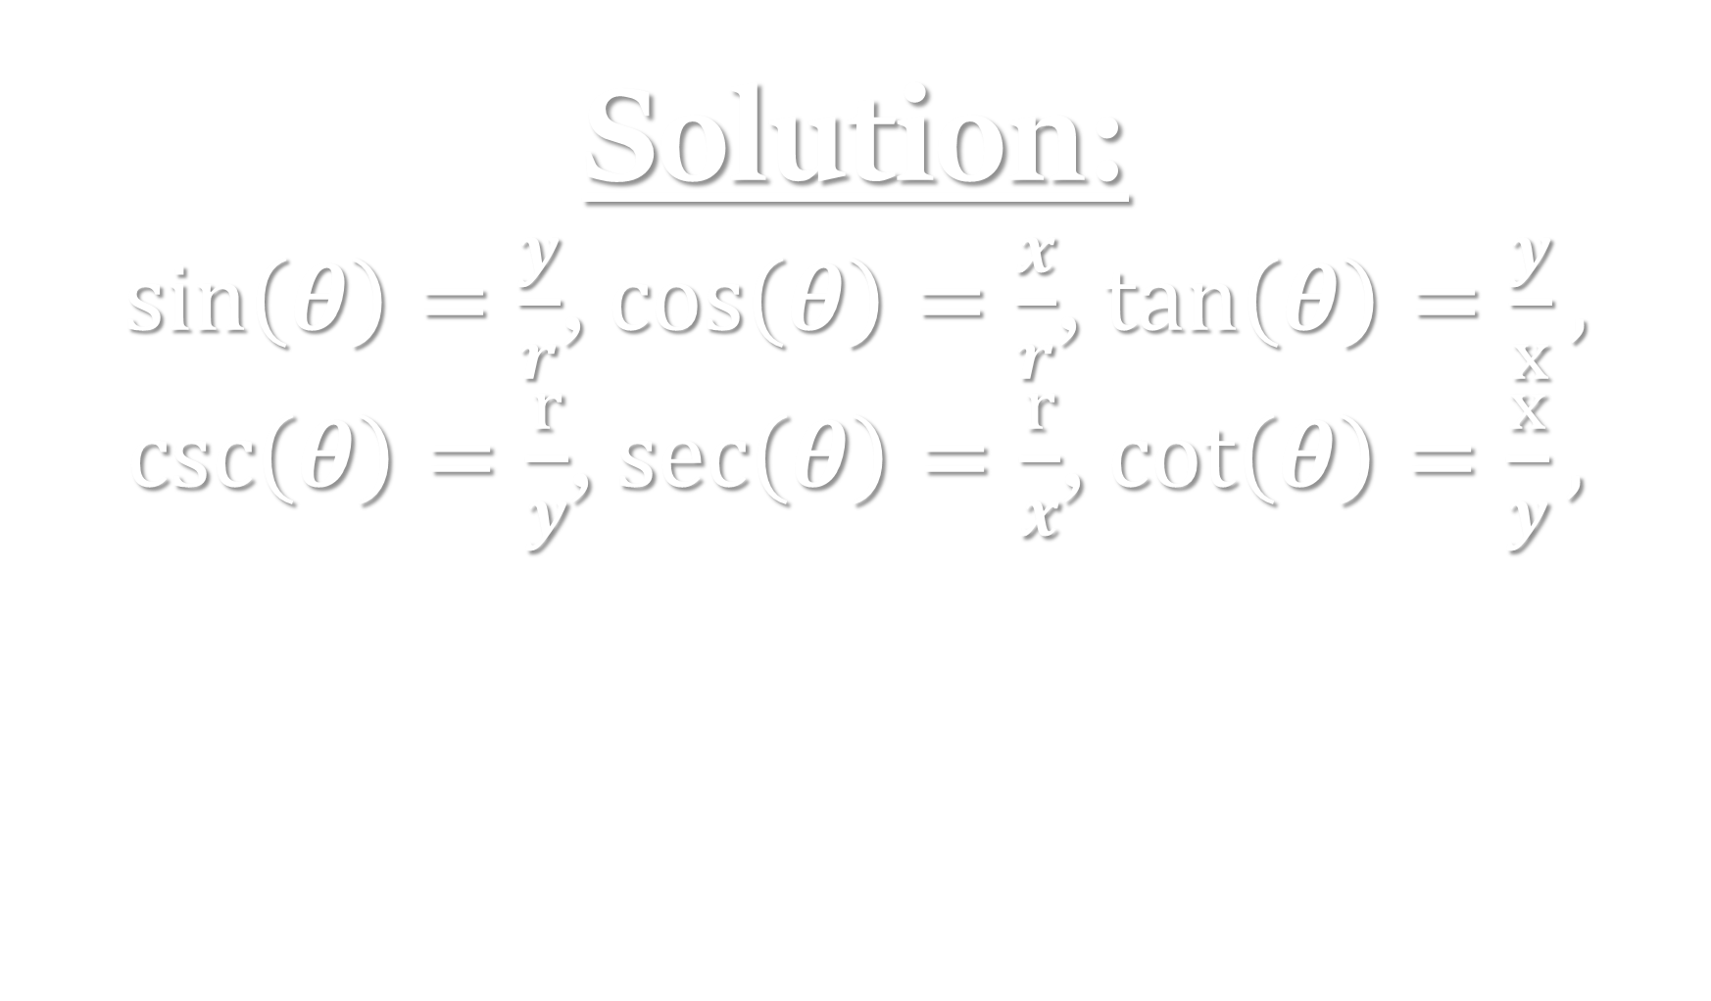
Solution:
$\sin\left(θ\right)=\frac{y}{r}$, $\cos\left(θ\right)=\frac{x}{r}$, $\tan\left(θ\right)=\frac{y}{x},$ $\csc\left(θ\right)=\frac{r}{y}$, $\sec\left(θ\right)=\frac{r}{x}$, $\cot\left(θ\right)=\frac{x}{y},$
$ 1000

Slide 31

Convert ${210}^{∘}$to radians.
Click here for the answer

Slide 32

Solution:
$$\frac{7π}{6}$$
$ 200

Slide 33

Convert $\frac{5π}{3}$ to degrees
Click here for the answer

Slide 34

Solution:
$${300}^{∘}$$
$ 400

Slide 35
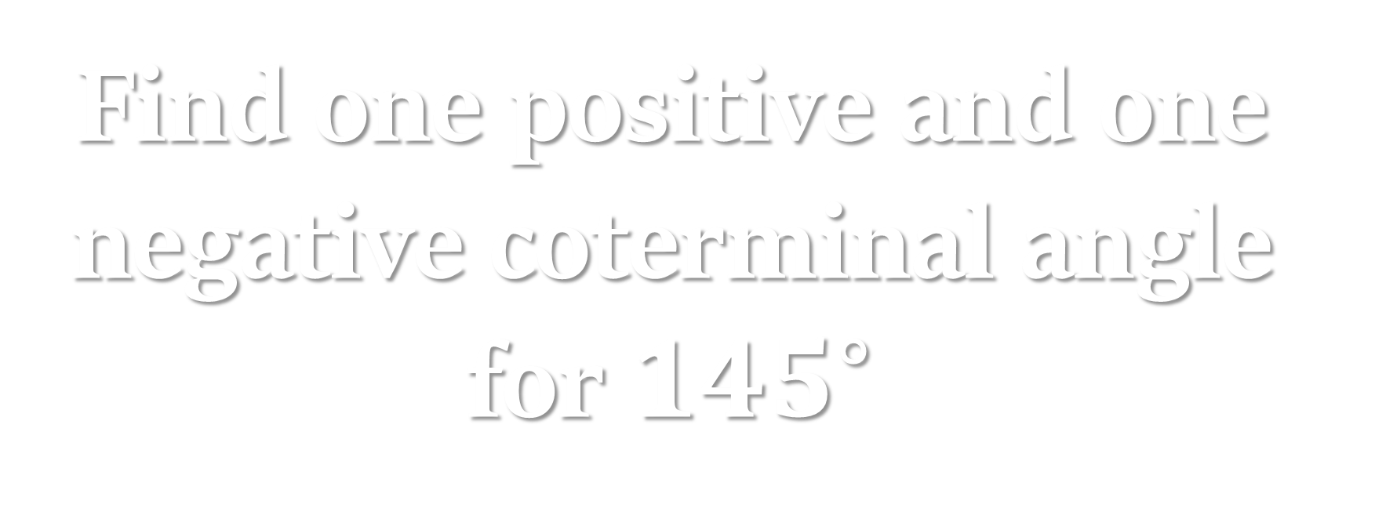
Find one positive and one negative coterminal angle for $145^{∘}$
Click here for the answer

Slide 36

Solution:
${505}^{∘}$, $−{215}^{∘}$
$ 600

Slide 37
Write the general solution for all coterminal angles in radians.
Click here for the answer

Slide 38
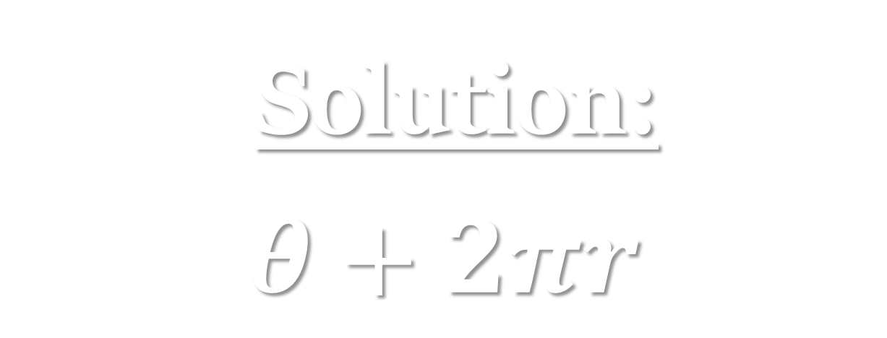
$ 800
Solution:
$$θ+2πr$$

Slide 39
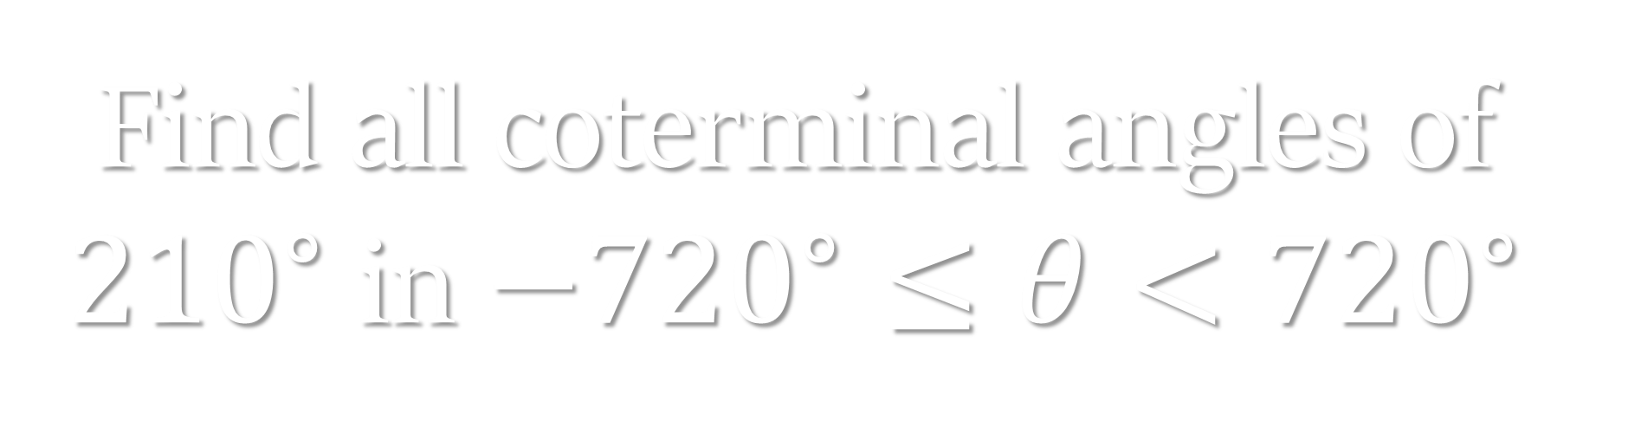
Find all coterminal angles of ${210}^{∘}$ in $−{720}^{∘}≤θ<{720}^{∘}$
Click here for the answer

Slide 40
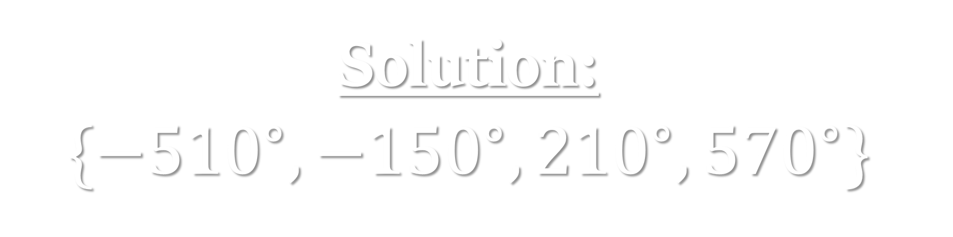
Solution:
$$\{−{510}^{∘},−{150}^{∘},{210}^{∘},{570}^{∘}\}$$
$ 1000

Slide 41

What are the coordinates of $\frac{5π}{6}$?
Click here for the answer

Slide 42
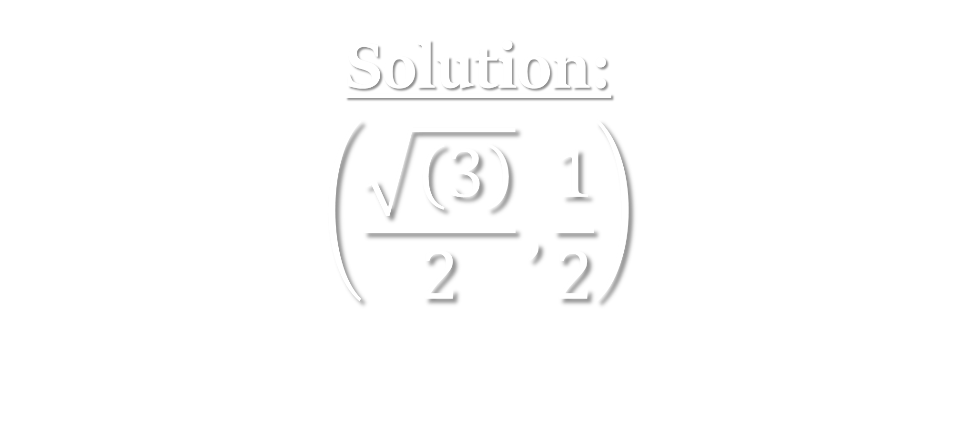
Solution:
$$\left(\frac{\sqrt{\left(3\right)}}{2},\frac{1}{2}\right)$$
$ 200

Slide 43
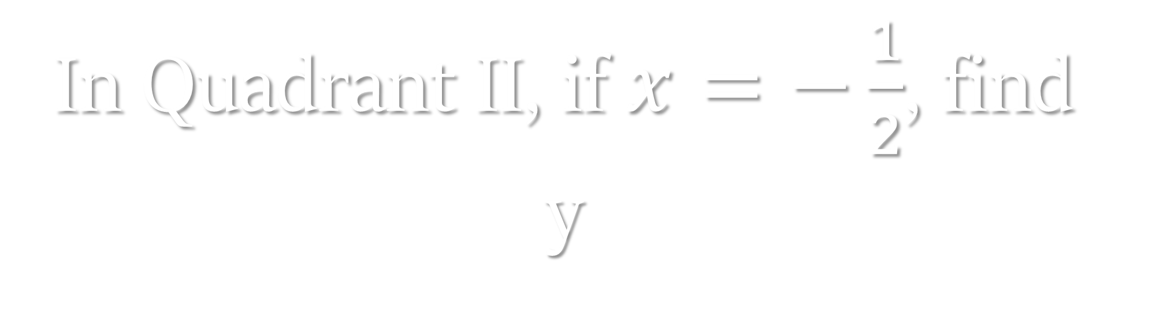
In Quadrant II, if $x=−\frac{1}{2}$, find y
Click here for the answer

Slide 44

Solution:
$$\frac{\sqrt{\left(3\right)}}{2}$$
$ 400

Slide 45
Which quadrants have negative sine values?
Click here for the answer

Slide 46
Solution:
Quadrants II & IV
$ 600

Slide 47

What is the reference angle for $\frac{5π}{6}$?
Click here for the answer

Slide 48

Solution:
$$\frac{π}{6}$$
$ 800

Slide 49
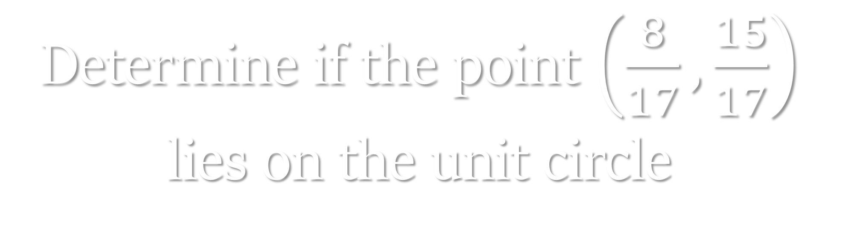
Determine if the point $\left(\frac{8}{17},\frac{15}{17}\right)$ lies on the unit circle
Click here for the answer

Slide 50
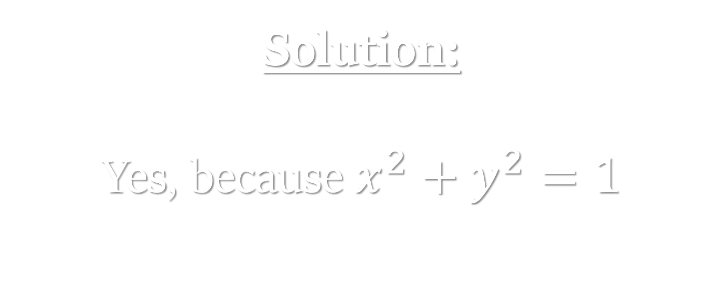
Solution:
Yes, because $x^{2}+y^{2}=1$
$ 1000

Slide 51

What is $\cos\left(θ\right)$ on the unit Circle
Click here for the answer

Slide 52
Solution:
x-coordinate
$ 200

Slide 53
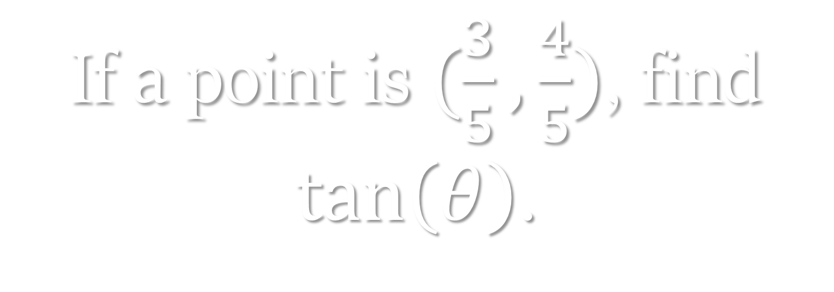
If a point is $(\frac{3}{5},\frac{4}{5})$, find $\tan\left(θ\right)$.
Click here for the answer

Slide 54
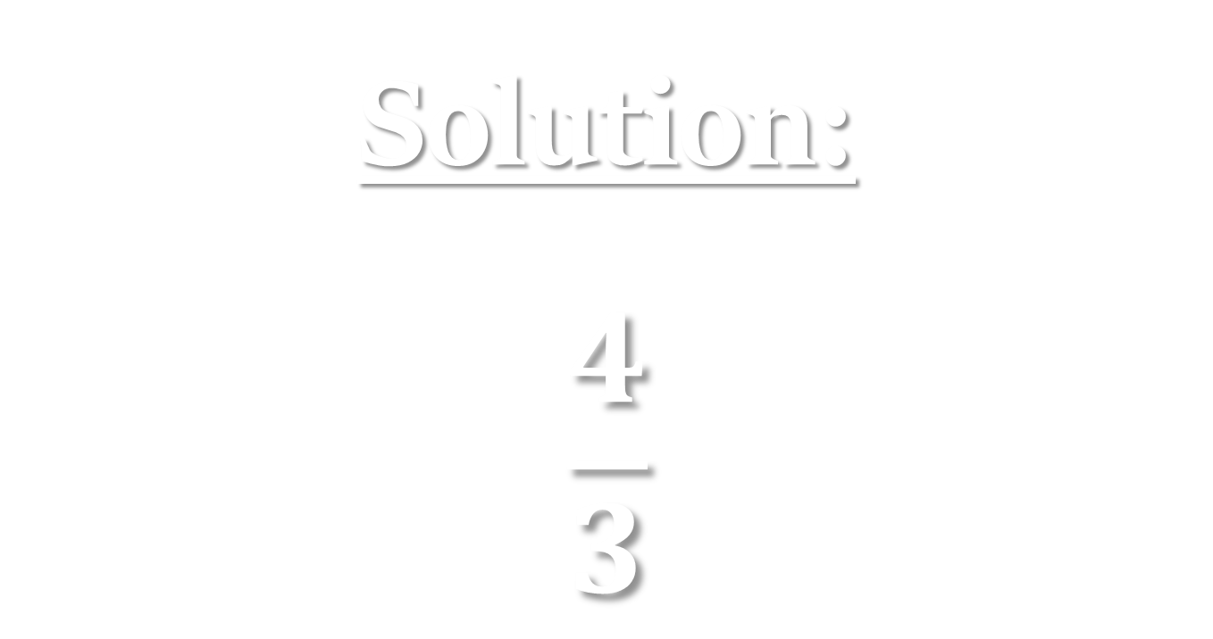
Solution:
$$\frac{4}{3}$$
$ 400

Slide 55
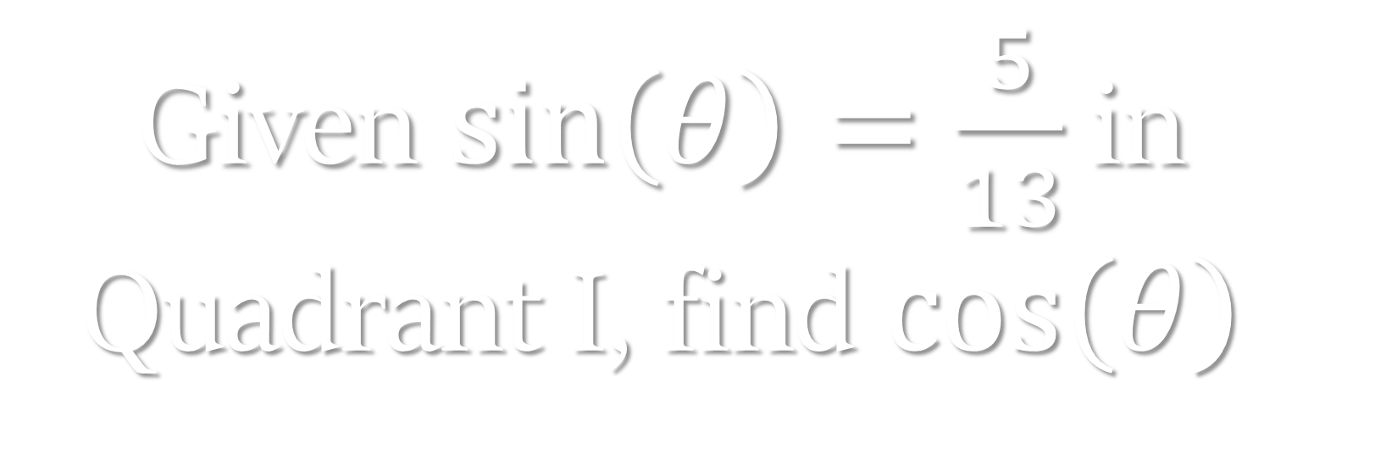
Given $\sin\left(θ\right)=\frac{5}{13}$ in Quadrant I, find $\cos\left(θ\right)$
Click here for the answer

Slide 56
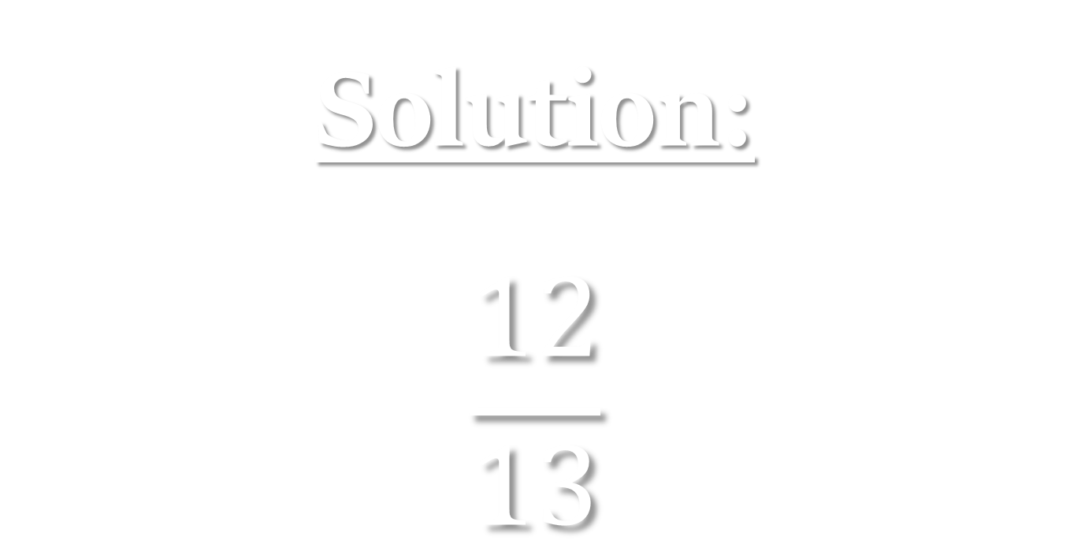
Solution:
$$\frac{12}{13}$$
$ 600

Slide 57
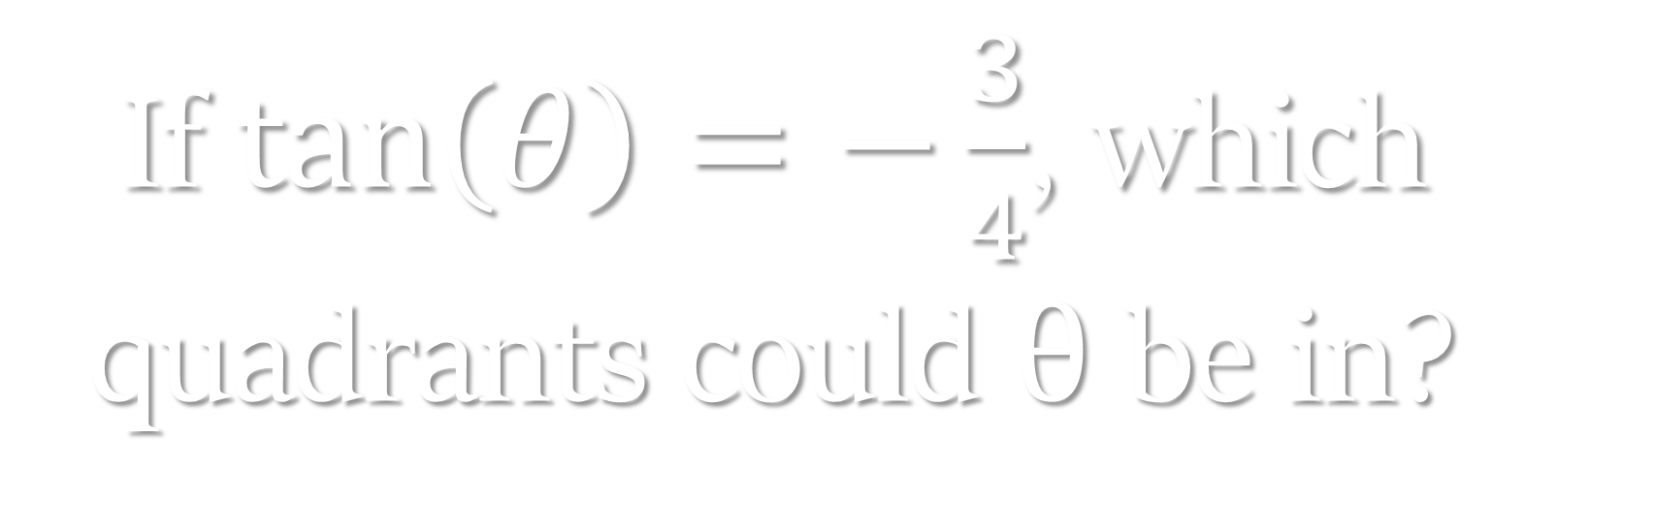
If $\tan\left(θ\right)=−\frac{3}{4}$, which quadrants could $θ$ be in?
Click here for the answer

Slide 58
Solution:
Quadrants II & IV
$ 800

Slide 59
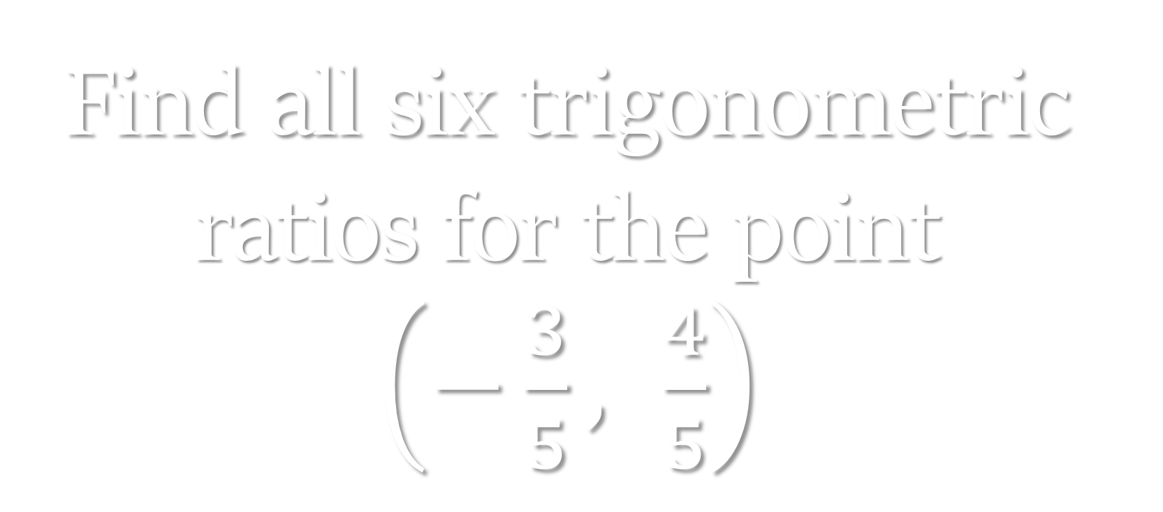
Find all six trigonometric ratios for the point $\left(−\frac{3}{5}, \frac{4}{5}\right)$
Click here for the answer

Slide 60
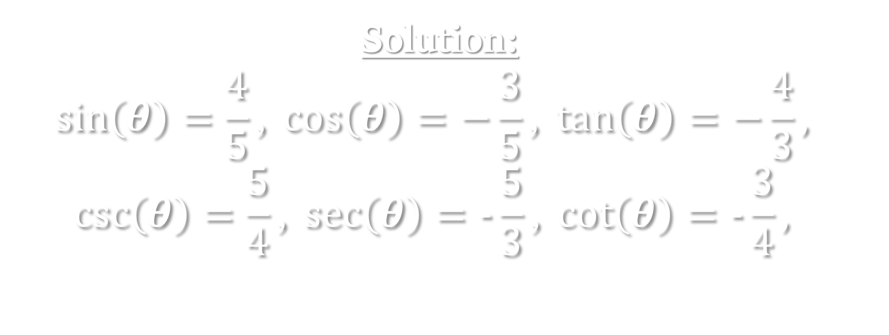
Solution:
$$\sin\left(θ\right)=\frac{4}{5}\text{, }\cos\left(θ\right)=−\frac{3}{5}\text{,} \tan\left(θ\right)=−\frac{4}{3},$$
$$\csc\left(θ\right)=\frac{5}{4}\text{, }\sec\left(θ\right)=-\frac{5}{3}\text{,} \cot\left(θ\right)=-\frac{3}{4},$$
$ 1000

Slide 61

Solve: $2\cos\left(θ\right)−1=0$
Click here for the answer

Slide 62

Solution:
$$\frac{π}{3},\frac{5π}{3}$$
$ 200

Slide 63

Solve: $sin(θ)=\frac{1}{2}$
Click here for the answer

Slide 64
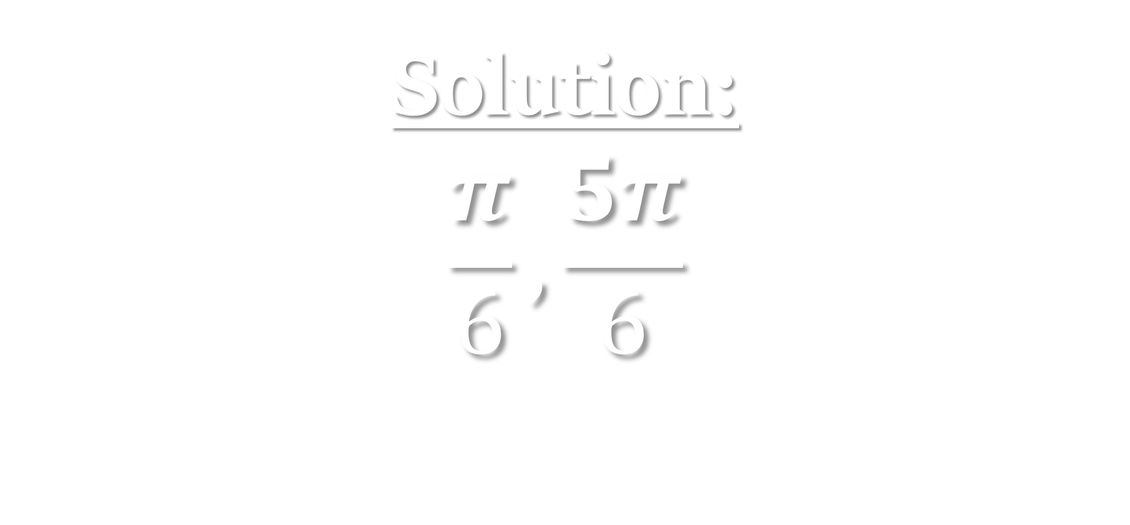
Solution:
$$\frac{π}{6},\frac{5π}{6}$$
$ 400

Slide 65
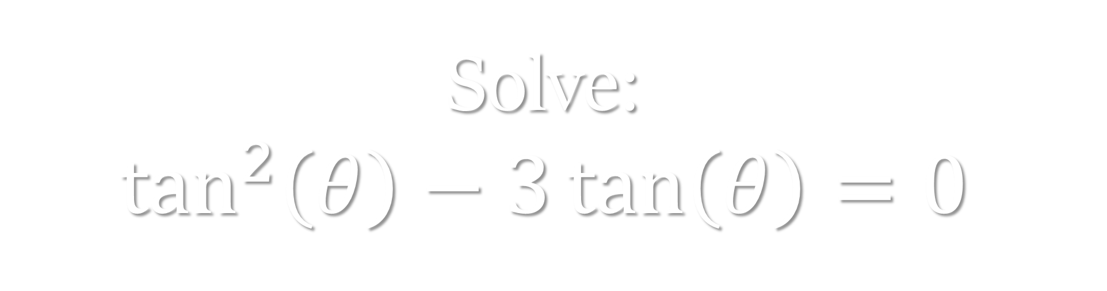
Solve:
$$\tan^{2}\left(θ\right)−3\tan\left(θ\right)=0$$
Click here for the answer

Slide 66
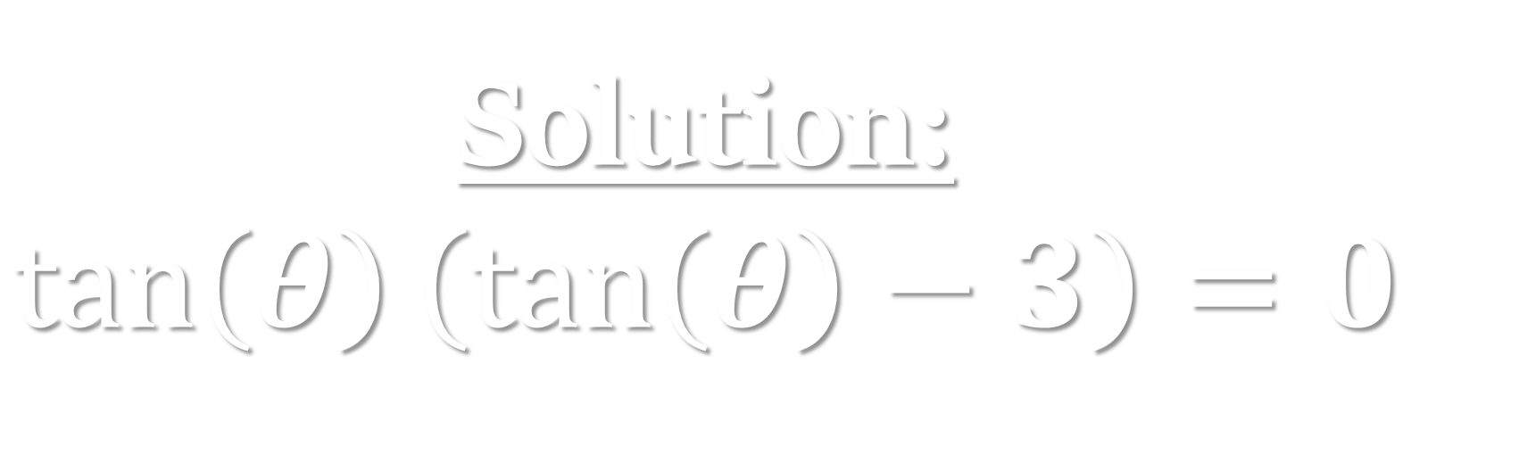
Solution:
$$\tan\left(θ\right)\left(\tan\left(θ\right)−3\right)=0$$
$ 600

Slide 67

Solve:
$$\tan\left(θ\right)=\sqrt{3}$$
Click here for the answer

Slide 68

Solution:
$$\frac{π}{3},\frac{4π}{3}$$
$ 800

Slide 69

Solve:
$$\cos\left(θ\right)=0$$
Click here for the answer

Slide 70

Solution:
$$\frac{π}{2},\frac{3π}{2}$$
$ 1000

Slide 71
What defines the Unit Circle?
Click here for the answer

Slide 72
Solution:
Radius =1, centered at the origin
$ 200

Slide 73
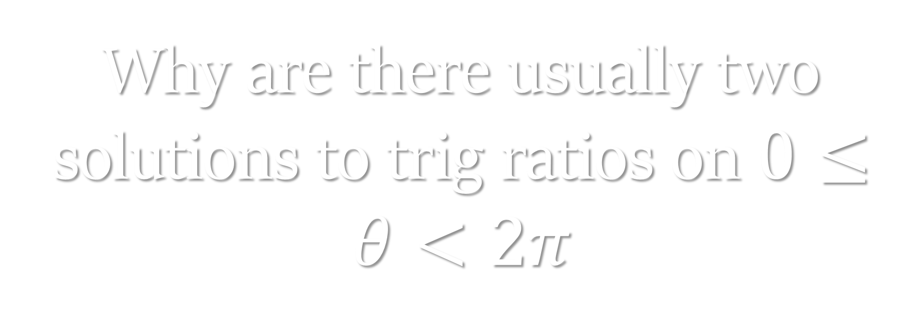
Why are there usually two solutions to trig ratios on $0≤θ<2π$
Click here for the answer

Slide 74
Solution:
Occur in multiple Quadrants
$ 400

Slide 75
How do you determine the sign of the trig ratios
Click here for the answer

Slide 76
Solution:
Based on the Quadrant (CAST rule)
$ 600

Slide 77
Why is cosine negative in Quadrant II?
Click here for the answer

Slide 78
Solution:
x-values are negative
$ 800

Slide 79
Explain how to check if a point lies on the unit circle.
Click here for the answer

Slide 80

Solution:
Verify $x^{2}+y^{2}=1$
$ 1000

Slide 81


Free Download:
https://slidelizard.com

