Slide 1
Recreating Real Life Buildings & Rooms In Minecraft
By Nicholas Ciarciaglini

Slide 2
What I will be recreating
I’ll recreate my favorite teacher’s (Mr. Vendramin) Classroom:
What I will need:
The dimensions of the floor, walls and roof.
The correct scale from Real life to Minecraft (1m : 1m)
NO partial meters

Slide 3
Scale, Surface Area, & volume
This is for all surface area, scale and the volume

Slide 4
Scale
$Scale Statement \left(SS\right)=orginal:model$
$SS=10.11 m:10 blocks$
$SS=2.022 m:2 blocks$
$SS=1.011 m:1 block$
$Scale Factor \left(SF\right)=\frac{orginal}{model}$
$SF=\frac{10.11 m}{10 blocks}$
$SF=\frac{2.022 m}{2 blocks}$
$SF=\frac{1 block}{1.011 m}$
$SF=1$

Slide 5
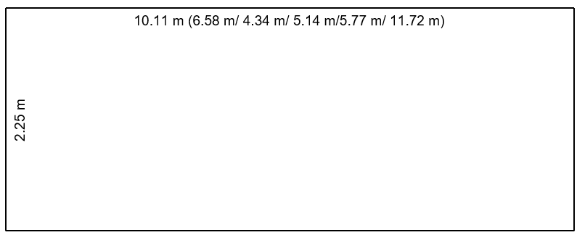
Real Room
This is the layout of the room and what measurements there are.

Slide 6
Area Real Room (Floor/ Roof)
Floor/Roof:
$11.72\left(5.77\right)=67.62 m^{2}$
$3.24\left(6.58\right)=21.32 m^{2}$
$67.62 m^{2}+21.32 m^{2}=88.94 m^{2}$

Slide 7
Area Real Room (Walls)
Walls:
$2.25\left(10.11\right)=22.75 m^{2}$
$2.25\left(6.58\right)=14.81 m^{2}$
$2.25\left(4.34\right)=9.77 m^{2}$
$2.25\left(5.14\right)=11.57 m^{2}$
$2.25\left(5.77\right)=12.98 m^{2}$
$2.25\left(11.72\right)=26.37 m^{2}$
$22.75 m^{2}+14.81 m^{2}+9.77 m^{2}+11.57 m^{2}+12.98 m^{2}+{26.37}^{2}=98.25 m^{2}$

Slide 8
Total Surface Area of real room:
Total Surface Area:
$2\left(88.94 m^{2}\right)+98.25 m^{2}=276.13 m^{2}$

Slide 9
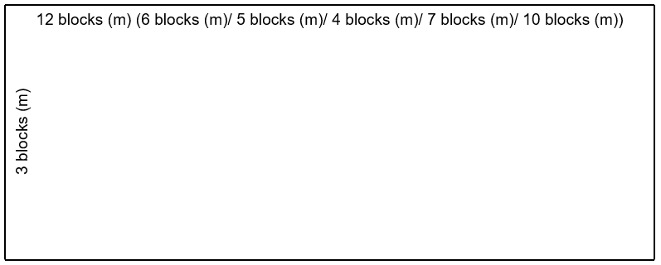
Minecraft Room
This is the layout of the room and what measurements there are.

Slide 10
Area Minecraft Room (Floor/ Roof)
Floor/Roof:
$6\left(12\right)=72 blocks^{2}$
$4\left(7\right)=28 blocks^{2}$
$72 blocks^{2}+28 blocks^{2}=100 bloc{ks}^{2}$

Slide 11
Area Minecraft Room (Walls)
Walls:
$3\left(12\right)=36 blocks^{2}$
$3\left(6\right)=18 blocks^{2}$
$3\left(5\right)=15 blocks^{2}$
$3\left(4\right)=12 blocks^{2}$
$3\left(7\right)=21 blocks^{2}$
$3\left(10\right)=30 blocks^{2}$
$36 blocks^{2}+18 blocks^{2}+15 blocks^{2}+12 blocks^{2}+21 blocks^{2}+30 blocks^{2}=132 blocks^{2}$

Slide 12
Total Surface area of Minecraft room:
Total Surface Area:
$2(100 blocks^{2})+132 blocks^{2}=332 blocks^{2}$

Slide 13
Volume of actual room
Actual Room:
$2.25 m \left(11.72 m\right)\left(5.77 m\right)=152.15 m^{3}$
$2.25 m\left(6.58 m\right)\left(4.34 m\right)=64.25 m^{3}$
$152.15 m^{3}+64.25 m^{3}=216.4 m^{3}$

Slide 14
Volume of Minecraft room
Minecraft Room:
$3\left(12\right)\left(6\right)=216 blocks^{3}$
$3\left(4\right)\left(7\right)=84 blocks^{3}$
$216 blocks^{3}+84 blocks^{3}=300 blocks^{3}$

Slide 15
Cost
Cost of all materials

Slide 16
Flooring
At, www.lowes.ca, AHF Commercial Vinyl Floor Tile - 12-in x 12-in - Speckled White Each VFT is $0.09 m^{2}$
$$\frac{100 m^{2}}{0.09 m^{2}}=1,111.11≈1,112$$
For one VFT: $\$125.55$ (not including taxes)
$$\$125.55×1,112=\$139,611.60$$

Slide 17
Lights
There are 8 lights in the Minecraft room. At, homedepot.ca, BOOST LIGHTING 4 ft. LED Shop Light 48W 4000K Warm Daylight 5500 Lumens Heavy Duty Linkable is $\$69.99$ (not including taxes)
$$8×\$69.99=\$559.92$$

Slide 18
Walls
4 blocks (m) wall:
The door is $2 m ×1 m=2m^{2}$
$4\left(3\right)−2\left(1\right)=10 m^{2}$
10 blocks (m) wall:
The door is $2 m ×1 m=2m^{2}$
$10\left(3\right)−2\left(1\right)=28 m^{2}$
5 blocks (m) wall:
$5×3=15 m^{2}$
7 blocks (m) wall:
$7×3=21 m^{2}$
6 blocks (m) wall:
We have 2 $2×2=4 m^{2}$ glass section on this wall.
$3\left(6\right)−2(4)=18−8=10 m^{2}$ wall
12 blocks (m) wall:
We have 1 $2×2=4 m^{2}$, 3 $1×2=2m^{2}$ glass sections on this wall.
$3\left(12\right)−(4+3\left(2\right))=36−10=26 m^{2}$ wall

Slide 19
Walls (glass)
$3\left(4 m^{2}\right)+3\left(2 m^{2}\right)=12m^{2}+6m^{2}=18 m^{2}$
At, homedepot.ca, Optix Clear Acrylic Sheet is $\$33.97$ (not including taxes)
$$18 in x 24 in=432 in$$
$$\frac{432}{x}=\frac{1}{0.0254}$$
$$0.2787m^{2}$$
$$\frac{18 m^{2}}{0.2787 m^{2}}=64.6 sheets≈65 sheets$$
$$65×\$33.97=\$2,208.05$$

Slide 20
Doors
At, homedepot.ca, Masonite 32-inch x 80-inch Primed 2 Panel Hollow Core Smooth Interior Door Slab is $\$142.00 each$ (not including taxes)
$$2×\$142.00=\$284.00$$

Slide 21
Walls (Material)
$$10 m^{2}+28 m^{2}+15 m^{2}+21 m^{2}+10 m^{2}+26 m^{2}=110 m^{2}$$
At, homedepot.ca, CGC Sheetrock 1/2 in. x 4 ft. x 8 ft. UltraLight Drywall Panel is $\$17.94$ each (not including taxes) and a $10\%$ discount if you buy 50 or more.
$$4\left(8\right)=32 ft^{2}$$
$$32 ft^{2}\left(\frac{1ft}{{0.3048}^{2} m}\right)=344 .45 m^{2}$$
$$\frac{344.45 m^{2}}{110 m^{2}}=3.131 panels≈4 panels$$
$$\$17.94×4=\$71.76$$

Slide 22
Furniture
11 tables and 20 chairs:
At, www.tradewest.ca, the tables are $\$199.00$ and the chairs are $\$82.99$ (Not including taxes)
$$\$199.00×11=\$2,189.00$$
10 tables have 2 chairs.
20 chairs
$$\$82.99×20=\$1,659.80$$
1 bookshelf:
At, www.tradewest.ca, the bookshelves are $\$529.00$ (Not including taxes)
$$\$529.00×1=\$529.00$$
1 standing desk:
At, www.tradewest.ca, the standing desks are $\$269.00$ (Not including taxes)
$$\$269.00×1=\$269.00$$

Slide 23
Total:
$$\$139,611.60+\$1,359.83+\$559.92+\$2,208.05+\$284.00+\$71.76+ \$2,198.00+\$1,659.00+\$529.00+\$269.00=\$148,750.16$$
So, the total cost is $\$148,750.16$

Slide 24
Loans
So, I need a loan of $\$150,000.00$.
If I pay $\$10,000.00$ each month how long, it will take me to repay the loan if it has an interest rate of $3.00\%$. If I paid $\$100,000.00$, in twenty-two months so far how many more month will it take me to repay the loan?
$$\$150,000.00−\$100,000.00=\$50,000.00$$
$$I=Prt$$
$$\$50,000.00=\left(\$150,000\right)\left(0.03\right)t$$
$$\$50,000=\$4,500t$$
$$\frac{\$50,000.00}{\$4,500.00}=\frac{\$4,500.00}{\$4,500.00}t$$
$$11.11=t$$
$$t≈12 months.$$
In total it took me 44 months to repay the loan. It costed $\$440,000$ to create this room.

Slide 25
Blocks Used: what they represent
White Concrete: It represents walls & Roof tiles
Redstone (not shown): It represents wiring
Redstone Lamps: It represents Light fixtures
Oak stairs: It represents tables and chairs
Oak Fence & Pressure Plate: It represents a standing desk
Lever: It represents a light switch
Glass Plane: It represents Glass
Black Concrete: It represents another room
Polished Diorite: It represents the flooring
Bookshelf: It represents a Bookcase
Door: It represents Doors

Slide 26
References
20x28 C-leg sit/stand desk. https://www.tradewest.ca/product-page/20x28-c-leg-sit-stand-desk
72"H steel bookcase. 72"H Steel Bookcase
AHF commercial vinyl floor tile - 12-in x 12-in - speckled white. https://www.lowes.ca/product/vct-tile/ahf-commercial-vinyl-floor-tile-12-in-x-12-in-speckled-white-16352?store_code=3208&cq_src=google_ads&cq_cmp=11543255263&cq_con=111377415086&cq_term=&cq_med=pla&cq_plac=&cq_net=g&cq_pos=&cq_plt=gp&&cm_mmc=paid_search-_-google-_-shopping_aw_lia_generic_storage-_-71700000075235897&gclid=Cj0KCQiAjbagBhD3ARIsANRrqEs4fT4U5dg2R0HWnT8j6GZcNeoMCCeoBEuC0sz65Tbm69rnQ-vLv5AaAjonEALw_wcB&gclsrc=aw.ds
BOOST LIGHTING 4 ft. LED shop light 48W 4000K warm daylight 5500 lumens heavy duty linkable . Retrieved https://www.homedepot.ca/product/boost-lighting-4-ft-led-shop-light-48w-4000k-warm-daylight-5500-lumens-heavy-duty-linkable/1001723592, from
Certainteed grenada 2-ft x 4-ft x 1/2-in ceiling tile panels - 8-pack. https://www.lowes.ca/product/ceiling-tiles/certainteed-grenada-2-ft-x-4-ft-x-12-in-ceiling-tile-panels-8-pack-591108?store_code=3208&cq_src=google_ads&cq_cmp=11543255263&cq_con=111377415086&cq_term=&cq_med=pla&cq_plac=&cq_net=g&cq_pos=&cq_plt=gp&&cm_mmc=paid_search-_-google-_-shopping_aw_lia_generic_storage-_-71700000075235897&gclid=Cj0KCQiAjbagBhD3ARIsANRrqEs7CeRc1Ydr4Q9M7sai80-rp0UgD90HhUCUhy0ukBbBKAUWGQQroloaAleaEALw_wcB&gclsrc=aw.ds
CGC sheetrock 1/2 in. x 4 ft. x 10 ft. UltraLight drywall panel. https://www.homedepot.ca/product/cgc-sheetrock-1-2-in-x-4-ft-x-10-ft-ultralight-drywall-panel/1000115026
Masonite 30-inch x 80-inch primed 2 panel hollow core smooth interior door slab. https://www.homedepot.ca/product/masonite-30-inch-x-80-inch-primed-2-panel-hollow-core-smooth-interior-door-slab/1000485123
Optix clear acrylic sheet - 080 inch x 18 inch x 24 inch. https://www.homedepot.ca/product/optix-clear-acrylic-sheet-080-inch-x-18-inch-x-24-inch/1000126291
Value 24x48 activity tables. https://www.tradewest.ca/product-page/value-24x48-activity-tables
Virco 9018 classic stacking chairs - 18"H . https://www.tradewest.ca/product-page/virco-9018-classic-stacking-chairs-18-h

